Slide 1

LINUX OS

Slide 2
DEFINE LINUX
Linux® is An operating system is the software that directly manages a system's hardware and resources, like CPU, memory, and storage. The OS sits between applications and hardware and makes the connections between all of your software and the physical resources that do the work.
Linux It is an open-source whose freely available code can be used freely
Compare to other os It was an secure language
Since Linux is an open-source operating system, with enough knowledge one can customize it as per their needs rather easily

Slide 3
HISTORY OF LINUX
The full form of LINUX is Lovable Intellect Not Using XP.
Linux was built by and named after Linus Torvalds
It was published on 19 sep 1991
Linux is a popular UNIX-based operating system.

Slide 4
What are the user interfaces in Linux?
The two main types of user interfaces (UIs) for Linux are the Graphical User Interface (GUI) and the Character User Interface (CUI):
A GUI uses graphics like images and icons to allow users to interact with a computer. It's used in many applications, including operating systems, web browsers, word processors, and photo editors.
A CUI uses text-based commands to allow users to interact with a computer. CUI was the precursor to GUI and was used in most early computers.
It's faster than GUI because it requires less memory.

Slide 5
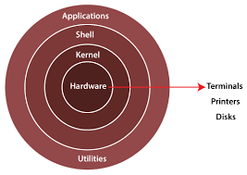
Sturcture of linux os

Slide 6
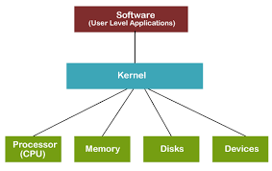
KERNAL
The Linux kernel is the core component of the Linux operating system (OS) that acts as the interface between a computer's hardware and its processes.
It's responsible for managing system resources and providing essential services.
The kernel's main functions include:
Memory management
Process management
Prcessor usage
System deadlock

Slide 7
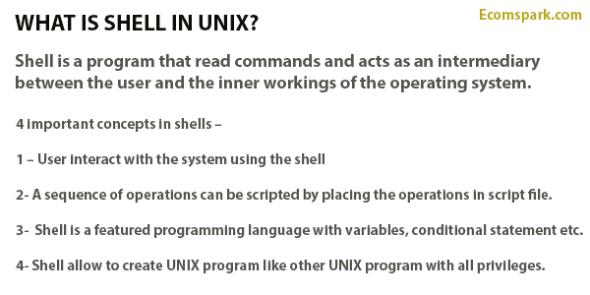
SHEEL
A shell in Linux is a command-line interpreter program that allows users to interact with the Linux operating system (OS)
Shells allow users to communicate efficiently and directly with their operating systems.

Slide 8
TERMINAL
The terminal is a default application on Linux operating systems and is used to perform a wide range of tasks, including:
Executing commands
Accessing system utilities
Manipulating files and directories
Configuring system settings
Installing programming languages
Writing scripts

Slide 9
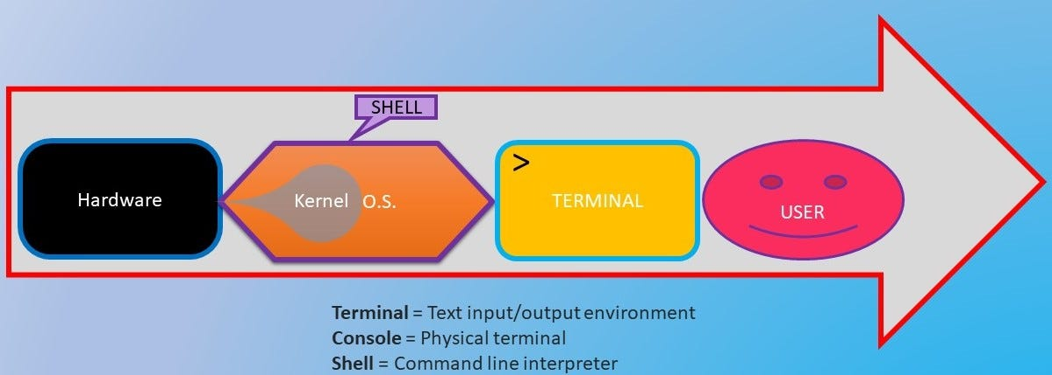
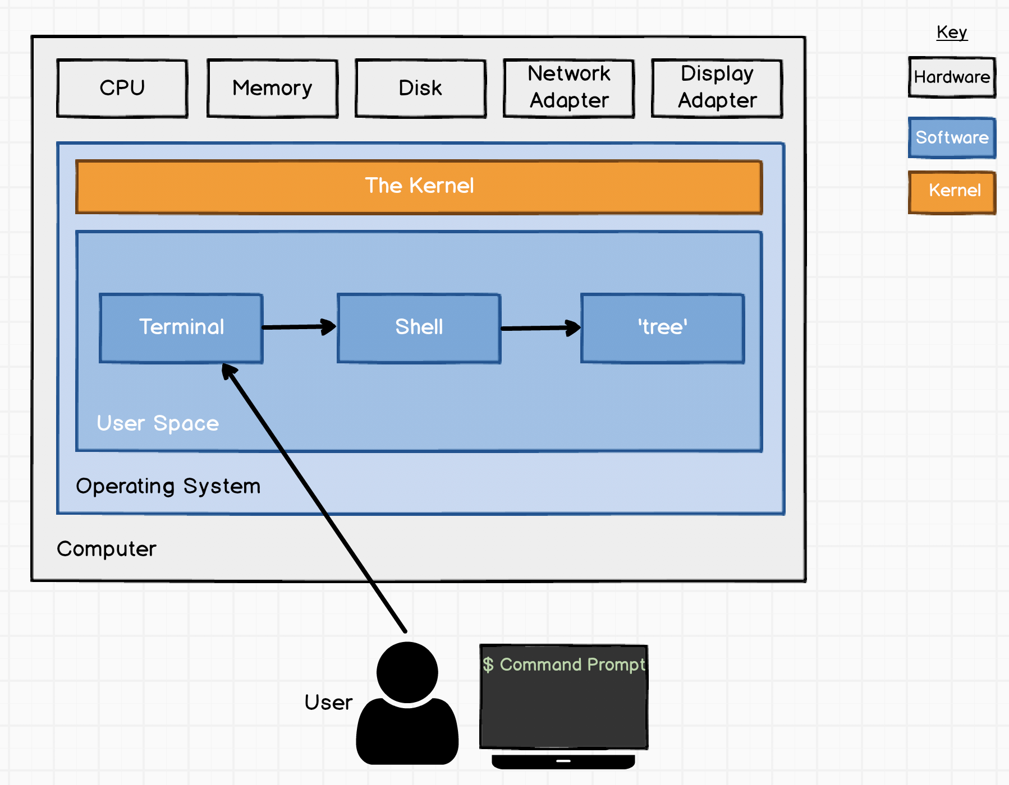

Slide 10
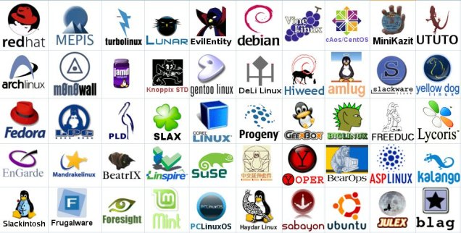
LIST TYPE OF LINUX OS

Slide 11
THANK YOU

